Slide 1
Autoregulation of local tissue blood flow
active
2.0
1.5
Blood flow (x normal)
Long term
1.0
0.5
0
50
100
150
200
250
Arterial pressure (mmHg)
Notes:
Autoregulation of local tissue blood flow
In any tissue of the body, an acute increase in arterial pressure causes immediate rise in blood flow. But, within less than a minute, the blood flow in most tissues returns almost to the normal level, even though the arterial pressure is kept elevated. This return of flow toward normal is called autoregulation of blood flow.
Note in the figure that between an pressure of about 70 mm Hg and 175 mm Hg, the blood flow increases only 30 per cent even though the arterial pressure increases more than 150 per cent.

Slide 2
1. The metabolic theory.
↓blood flow
↑vasodilator substances
vasodilatation
↑blood flow
Wash off vasodilator substances
vasoconstriction
Notes:
1. The metabolic theory.
According to this theory, the greater the rate of metabolism or the less the availability of oxygen or some other nutrients to a tissue, the greater the rate of formation of vasodilator substances in the tissue cells. The vasodilator substances then are believed to diffuse through the tissues to the precapillary sphincters, metarterioles, and arterioles to cause dilation. Some of
the different vasodilator substances that have been suggested are adenosine, carbon dioxide, adenosine phosphate compounds, histamine, potassium ions, and hydrogen ion.
In summary, when blood flow to the tissue is↓→ vasodilator substances will be accumulated, lead to vasodilatation.
& when blood flow is↑→ these substances will be washed away, lead to vasoconstriction

Slide 3
2. The myogenic theory
Smooth muscle
Lumen
Notes:
2. The myogenic theory
This theory is based on the observation that sudden stretch of small blood vessels causes the smooth muscle of the vessel wall to contract for a few seconds. Therefore, it has been proposed that when high arterial pressure stretches the vessel, this in turn causes reactive vascular constriction that reduces blood flow nearly back to normal. Conversely, at low pressures, the degree of stretch of the vessel is less, so that the smooth muscle relaxes and allows increased flow.
Myogenic contraction is initiated by stretch-induced vascular depolarization, which then rapidly increases calcium ion entry from the extracellular fluid into the cells, causing them to contract.

Slide 4
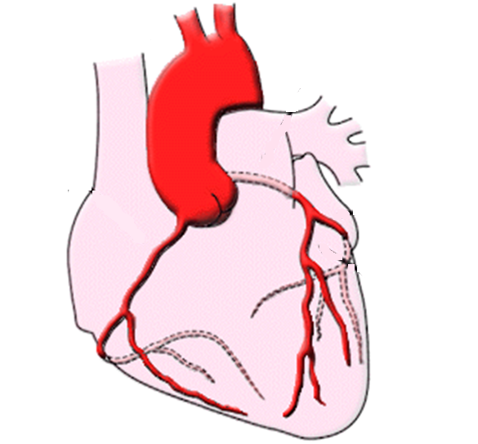
Coronary circulation
Aorta
Lt coronary A.
Circumflex A.
Rt coronary A.
Lt ant. Descending A.
225 ml/min
4 -5 % of CO
Notes:
Coronary circulation
The are two main coronary arteries that supply the myocardium arise from the sinuses behind two of the cusps of the aortic valve at the root of the aorta.
The left coronary artery supplies mainly the anterior and left lateral portions of the left ventricle,
The right coronary artery supplies most of the right ventricle as well as the posterior part of the left ventricle in 80 to 90 per cent of people.
Most of the coronary venous blood flow from the left ventricular muscle returns to the right atrium of the heart by way of the coronary sinus—which is about 75 per cent of the total coronary blood flow and most of the coronary venous blood from the right ventricular muscle returns through small anterior cardiac veins that flow directly into the right atrium
The resting coronary blood flow in the human being averages about 225 ml/min, which is about 4 to 5 per cent of the total cardiac output.

Slide 5
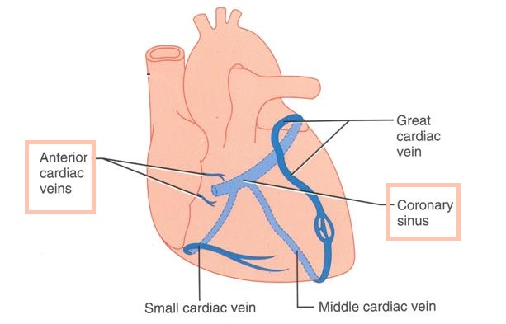

Slide 6
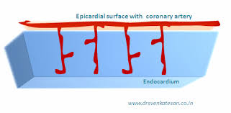
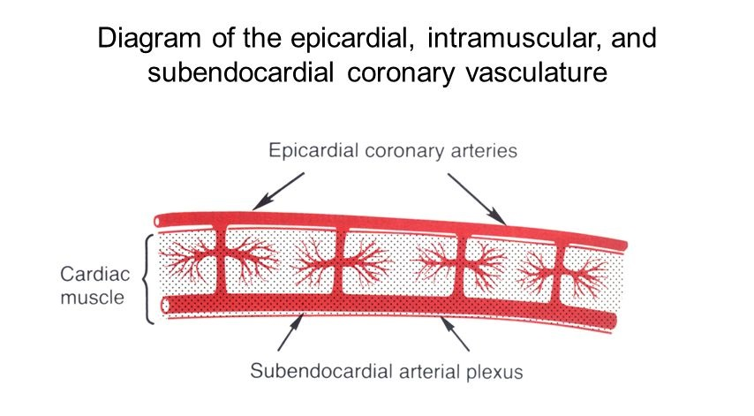

Slide 7
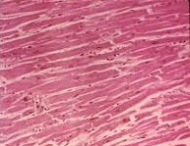
Pressure gradients & flow in the coronary vessels
Pressure difference |  | Pressure (mmHg)
right vent | Left vent | right vent | Left vent | aorta
95 | 1- | 25 | 121 | 120 | systole
80 | 80 | 0 | 0 | 80 | diastole
During diastole
During systole
120
120
80
0
25
121
Right ventricle
Left ventricle
Both ventricles
Notes:
Pressure gradients & flow in the coronary vessels:
The heart is a muscle that compresses its blood vessels when it contracts. The pressure inside the left ventricle is slightly higher than in the aorta during systole. Consequently, flow occurs only during diastole in the arteries supplying the subendocardial portion of the left ventricle.
Because diastole is shorter when the heart rate is high, left ventricular coronary flow is reduced during tachycardia.
On the other hand, the pressure differential between the aorta and the right ventricle, and the differential between the aorta and the atria, are somewhat greater during systole than during diastole. Consequently, coronary flow in those parts of the heart is not reduced during systole.
Because no blood flow occurs during systole in the subendocardial portion of the left ventricle, this region is prone to ischemic damage and is the most common site of myocardial infarction.

Slide 8
Control of Coronary Blood Flow
Local chemical factors
Neural factors
Adenosine
potassium ions
hydrogen ions
carbon dioxide
bradykinin
SNS
PNS
Notes:
Control of Coronary Blood Flow
Local chemical factors
Local muscle metabolism is the primary controller of coronary flow. Blood flow through the coronary system is regulated mostly by local arteriolar vasodilation in response to cardiac muscle need for nutrition. That is, whenever the vigor of cardiac contraction is increased, the rate of coronary blood flow also increases. Conversely, decreased heart activity is accompanied by decreased coronary flow.

Slide 9
Neural factors
Parasympathetic
direct effects
indirect effects
Sympathetic
direct effects
indirect effects
Notes:
Nervous Control of Coronary Blood Flow
Stimulation of the autonomic nerves to the heart can affect coronary blood flow both directly and indirectly.
The direct effects result from action of the nervous transmitter substances acetylcholine from the vagus nerves and norepinephrine and epinephrine from the sympathetic nerves on the coronary vessels themselves.
The indirect effects result from secondary changes in coronary blood flow caused by increased or decreased activity of the heart.

Slide 10
sympathetic
direct effects
indirect effects
Vasoconstriction
↑ HR
↑ contractility
↑metabolic rate
Vasodilatation
Notes:
Sympathetic stimulation:
The direct effects:
There is extensive sympathetic innervation to the coronary vessels. The sympathetic transmitter substances norepinephrine and epinephrine can have either vascular constrictor or vascular dilator effects depending on the type of the receptors in the blood vessel walls. The constrictor receptors are called alpha receptors and the dilator receptors are called beta receptors. Both alpha and beta receptors exist in the coronary vessels. The sympathetic stimulation usually causes slight overall coronary constriction.
The indirect effects:
which are mostly opposite to the direct effects, play a far more important role in normal control of coronary blood flow
The sympathetic stimulation, which releases norepinephrine and epinephrine, increases both heart rate and heart contractility as well as increases the rate of metabolism of the heart. In turn, the increased metabolism of the heart sets off local blood flow regulatory mechanisms for dilating the coronary vessels, and the blood flow increases approximately in proportion to the metabolic needs of the heart muscle.
Whenever the direct effects of nervous stimulation alter the coronary blood flow in the wrong direction, the metabolic control of coronary flow usually overrides the direct coronary nervous effects within seconds.

Slide 11
Parasympathetic
direct effects
indirect effects
Vasodilatation
↓HR
slightly ↓contractility
↓metabolic rate
Vasoconstriction
Notes:
Parasympathetic stimulation:
The direct effects:
The distribution of parasympathetic (vagal) nerve fibers to the ventricular coronary system is not very great. However, the acetylcholine released by parasympathetic stimulation has a direct effect to dilate the coronary arteries
The indirect effects:
which are mostly opposite to the direct effects, play a far more important role in normal control of coronary blood flow. Vagal stimulation with its release of acetylcholine, slows the heart and has a slight depressive effect on heart contractility. These effects in turn decrease cardiac oxygen consumption and, therefore, indirectly constrict the coronary arteries.

